Slide 1
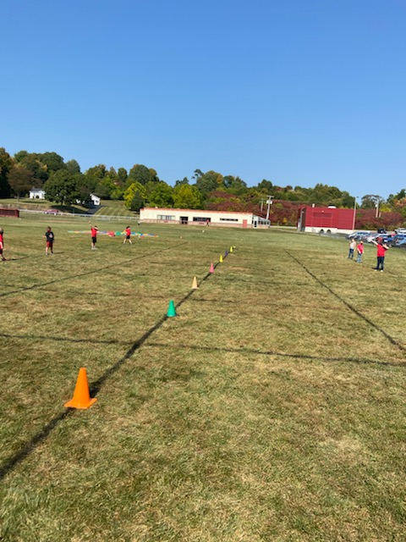
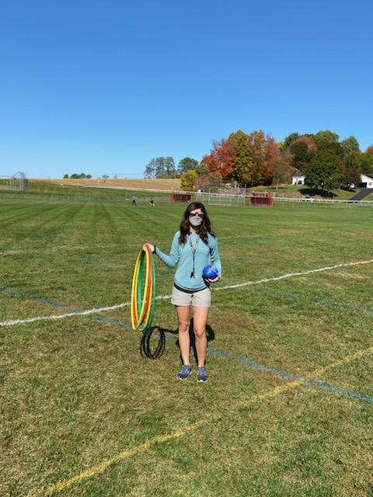
Physical Education
Middle School
Coach Breault
Grades 6-7

Slide 2
Contact Information
Coach Breault
Email: Kbreault@hartfordcsd.org
Phone: 518-632-5222 ext 209

Slide 3
About Me
I have been teaching Physical Education for 12 years at HCS. I love being a Tanager and showing my school spirit.
I have coached basketball and softball at HCS but currently Coach Volleyball.
I love to travel, enjoy the beach, hike, spend time with my family and of course stay active.
My favorite hobbies include working out, kayaking, hiking, and playing sports; volleyball, golf and tennis are just a few.

Slide 4
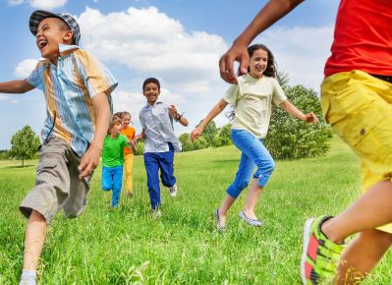
Physical Education
NYS requires at least
90 minutes of Physical Education a week for middle school students (7-12)
120 minutes of Physical Education a week for elementary students (K-6)

Slide 5
COVID Changes to PE:
Due to the unique circumstances surrounding COVID-19, students will not be changing, nor will they have use of the locker rooms. Our gymnasium is currently in use as cafeteria space and overflow space giving us limited use. Because of this, we will be going outside for PE as much as possible. With that in mind, please have your child dress appropriately for activity on gym days.
Things to remember:
Students may choose to wear a gaiter mask or lanyard on PE days. This will help with taking masks on/off when outside. This will also prevent masks from falling on the ground and/or getting dirty, lost, etc.
Please remember sneakers on gym days. We will NOT be lending sneakers this year due to COVID.
Please check the weather on PE days and have students dress accordingly. Hoodies, jackets, sweatpants, old sneakers, are a good idea as we start to move into fall weather.
Unfortunately we will not be getting drinks from the water fountain. Students should bring in a water bottle to hydrate after class.

Slide 6
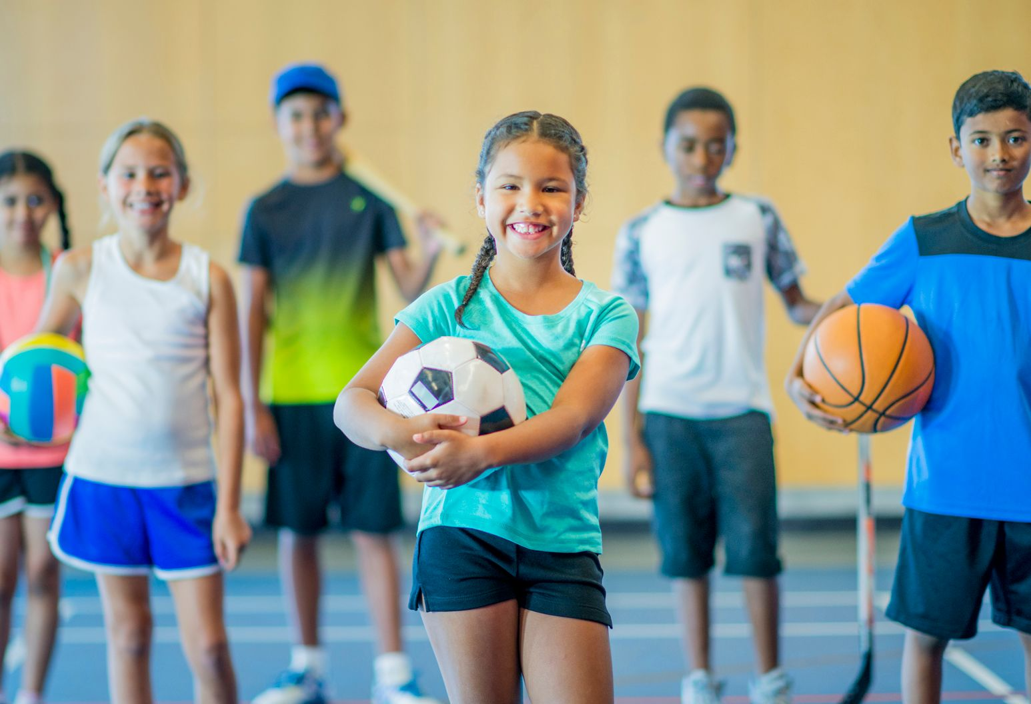
PROPER ATTIRE
Students must come to school prepared on the days they have PE. Students will NOT be allowed into the locker room for any reason to change.
Comfortable workout clothes and sneakers are recommended.
Students with earlier PE classes may want to bring a change of sneakers and socks for that day as it will most likely be very wet out.
We will be going outside most days so please check the weather to dress accordingly.
Students may choose to purchase a gaiter mask for easy take on and off when going outdoors.
The recommended distance for participating in physical activity is 12 ft. We will do our best to maintain this distance when outside during class. If students will be working closer than 12’, masks will be required.
As the weather begins to get colder, please remember to dress appropriately for all weather (coats, hats, gloves, double socks, etc).

Slide 7
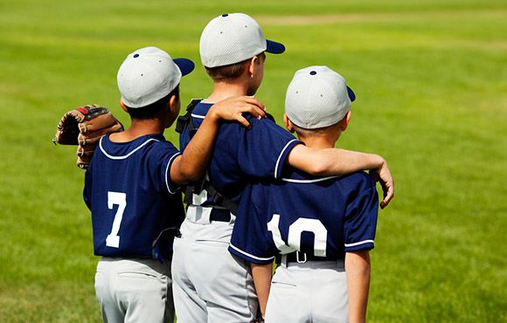
CLASS REQUIREMENTS
Be respectful at all times
Arrive on time to class
Participate and make a satisfactory effort
Display good sportsmanship, follow rules and be aware of safety for themselves and others

Slide 8
REMOTE LEARNING IN PE
*In circumstances where we are not in school, we are prepared and ready to keep your child healthy and active.
Students will be expected to log on google classroom throughout the week and complete an activity log.
Each student has been given a google classroom code and should check this each week for assignments.
Students are required to be active for at least 60-120 minutes a week.
Activity logs should include a combination of aerobic and anaerobic exercises.
- Students can check google classroom for activity ideas, and guided workouts.

Slide 10
Activity Log: Example
Monday 10/5 | Bike Ride 15 min | Fitness workout: Pushup Challenge | Baseball practice 30 min | TOTAL MIN 45 minutes
Tuesday 10/6 | Morning run 1 Mile: 10 min | Fitness Workout: Leg Day Squats Lunges | Darabee Workout (online) 15 min | TOTAL MIN 30 min

Slide 11
Grading
75% Class Participation, Effort, Sportsmanship
Students must come to class prepared with sneakers to participate.
25% Assignments
Students are required to complete activities during remote learning days. Students must complete assignments weekly.
*Remote Learners*
100% Activity logs and Assignments

Slide 12
I look forward to a great year at HCS!
Thanks,
Coach Breault

